Slide 1
Dimensionality Reduction Part 1: PCA and kPCA
Ng Yen Kaow

Slide 2
Dimensionality Reduction
Linear methods
PCA (Principal Component Analysis)
cMDS (Classical Multidimensional Scaling)
Non-linear methods
kPCA (Kernel PCA)
mMDS (Metric MDS)
Isomap
LLE (Locally Linear Embedding)
t-SNE (t-distributed Stochastic Neighbor Embedding)
UMAP (Uniform Manifold Approximation and Projection)

Slide 3
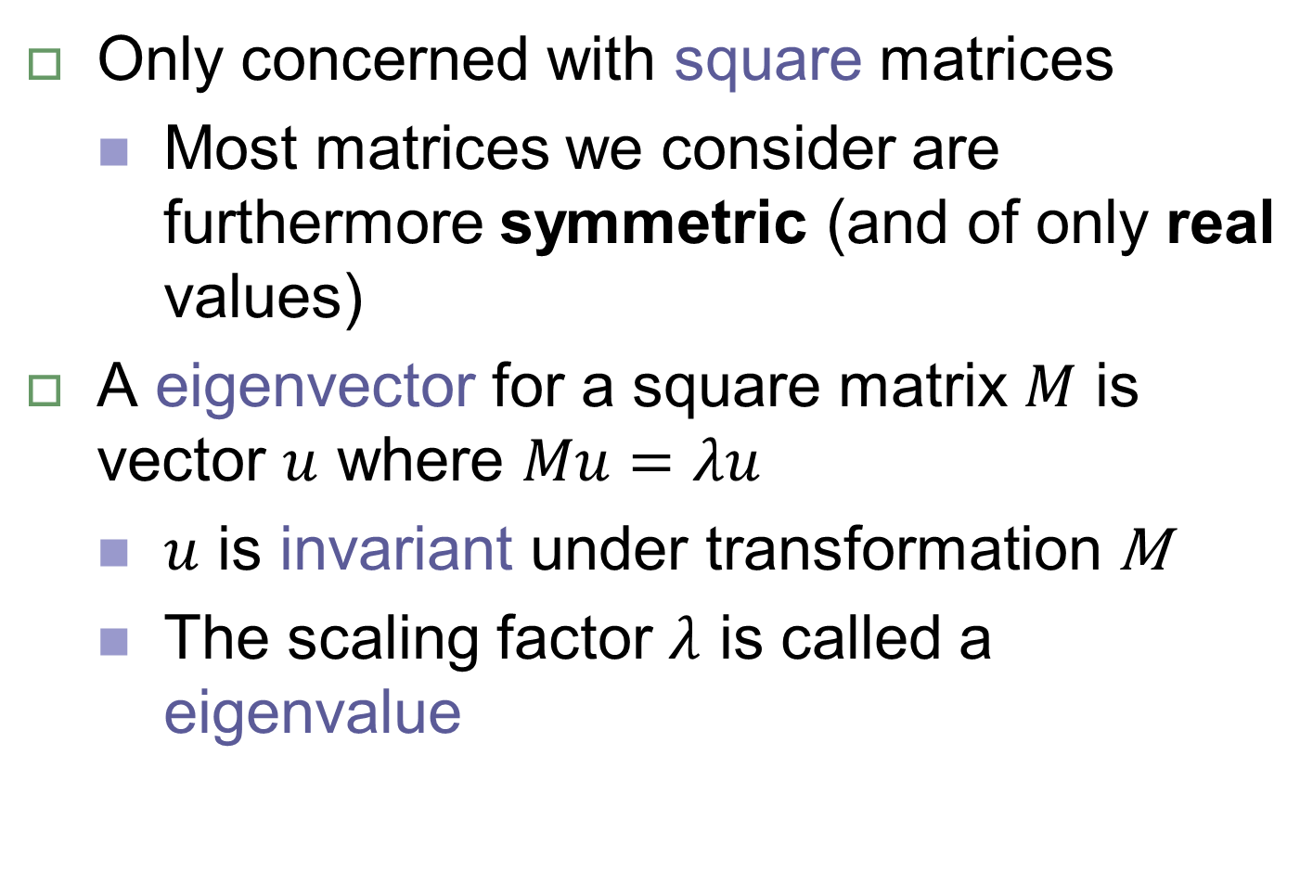
Eigenvectors and eigenvalues
Only concerned with square matrices
Most matrices we consider are furthermore symmetric (and of only real values)
A eigenvector for a square matrix $M$ is vector $u$ where $Mu=λu$
$u$ is invariant under transformation M
The scaling factor $λ$ is called a eigenvalue

Slide 4
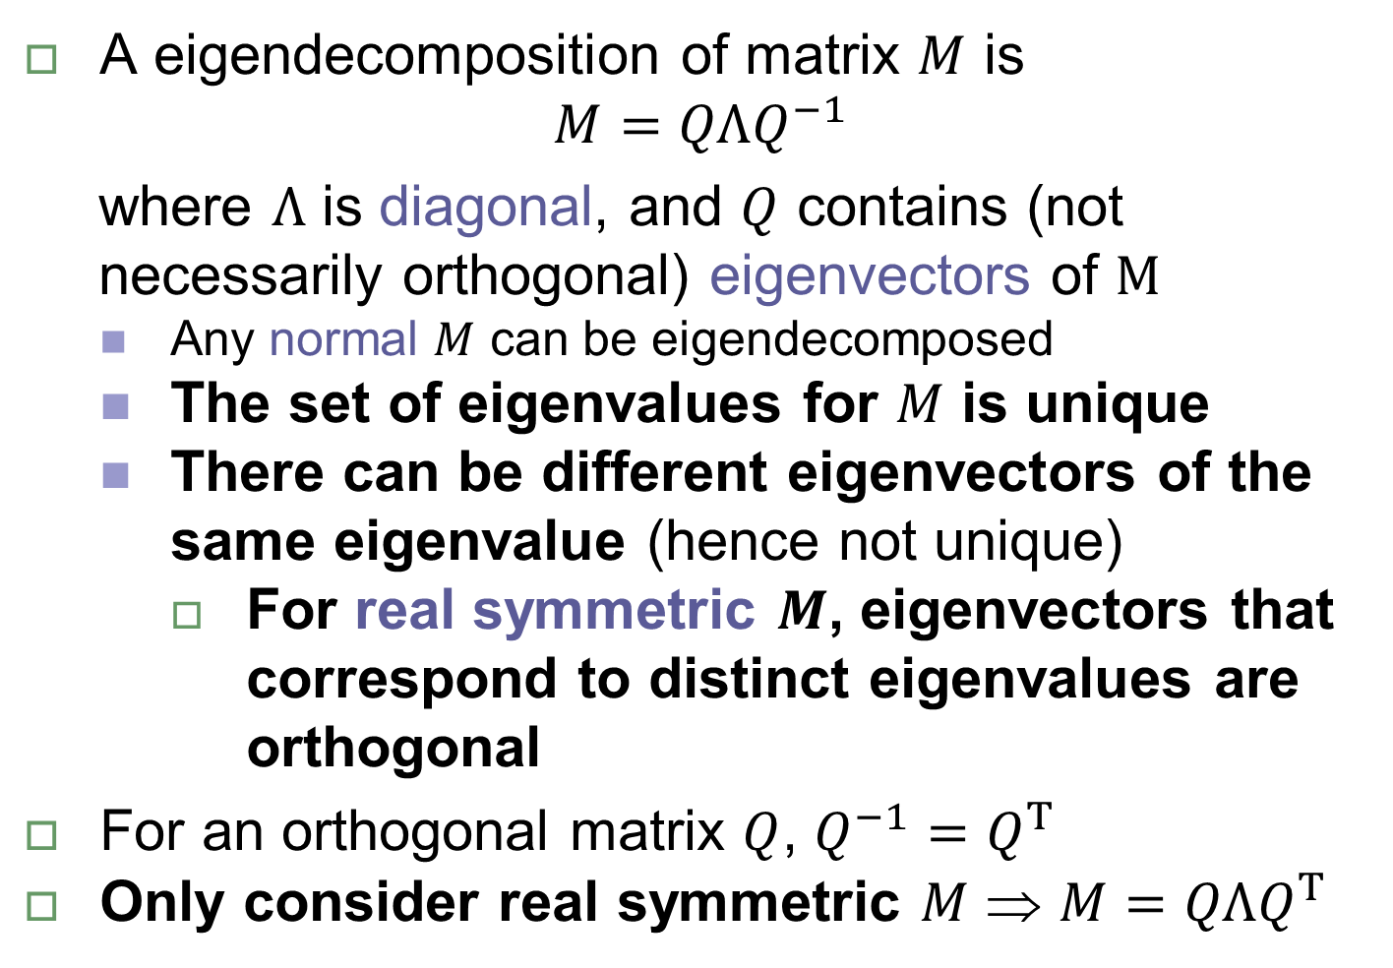
Eigendecomposition
A eigendecomposition of matrix $M$ is
$$M=QΛQ^{−1}$$
where $Λ$ is diagonal, and $Q$ contains (not necessarily orthogonal) eigenvectors of $M$
Any normal $M$ can be eigendecomposed
The set of eigenvalues for $M$ is unique
There can be different eigenvectors of the same eigenvalue (hence not unique)
For real symmetric $M$, eigenvectors that correspond to distinct eigenvalues are orthogonal
For an orthogonal matrix $Q$, $Q^{−1}=Q^{Τ}$
Only consider real symmetric $M$ ⇒ $M=QΛQ^{Τ}$

Slide 5
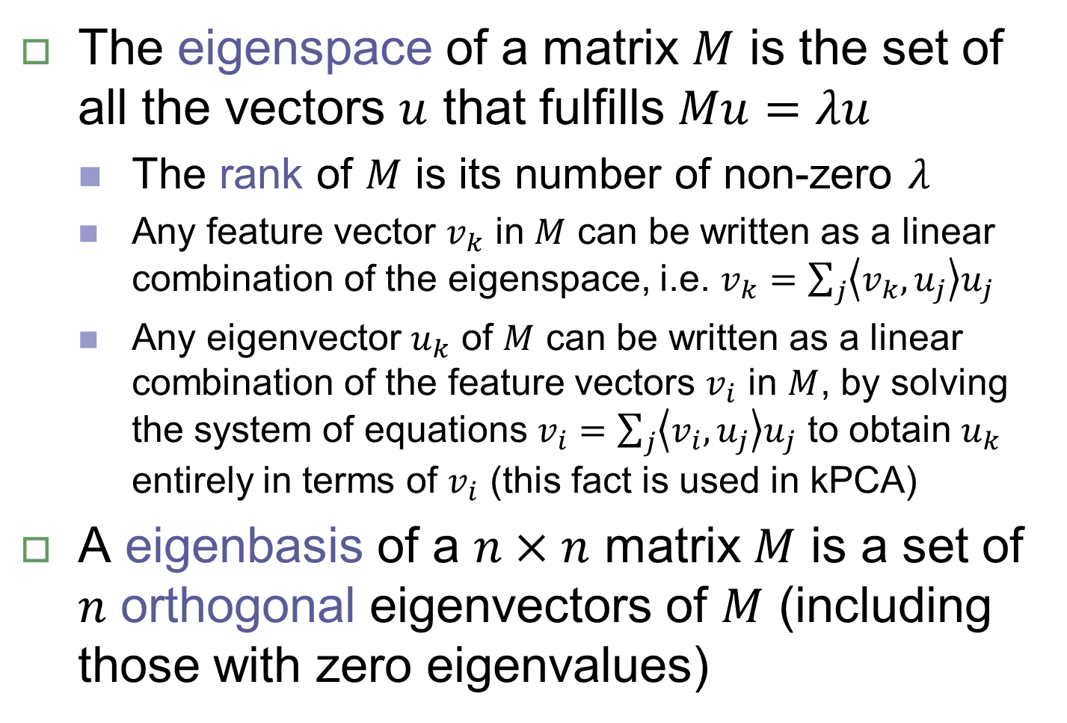
Eigenspace
The eigenspace of a matrix $M$ is the set of all the vectors $u$ that fulfills $Mu=λu$
The rank of $M$ is its number of non-zero $λ$
Any feature vector $v_{k}$ in $M$ can be written as a linear combination of the eigenspace, i.e. $v_{k}=\sum_{j}{\left\langle v_{k},u_{j}\right\rangle u_{j}}$
Any eigenvector $u_{k}$ of $M$ can be written as a linear combination of the feature vectors $v_{i}$ in $M$, by solving the system of equations $v_{i}=\sum_{j}{\left\langle v_{i},u_{j}\right\rangle u_{j}}$ to obtain $u_{k}$ entirely in terms of $v_{i}$ (this fact is used in kPCA)
A eigenbasis of a $n×n$ matrix $M$ is a set of $n$ orthogonal eigenvectors of $M$ (including those with zero eigenvalues)

Slide 6

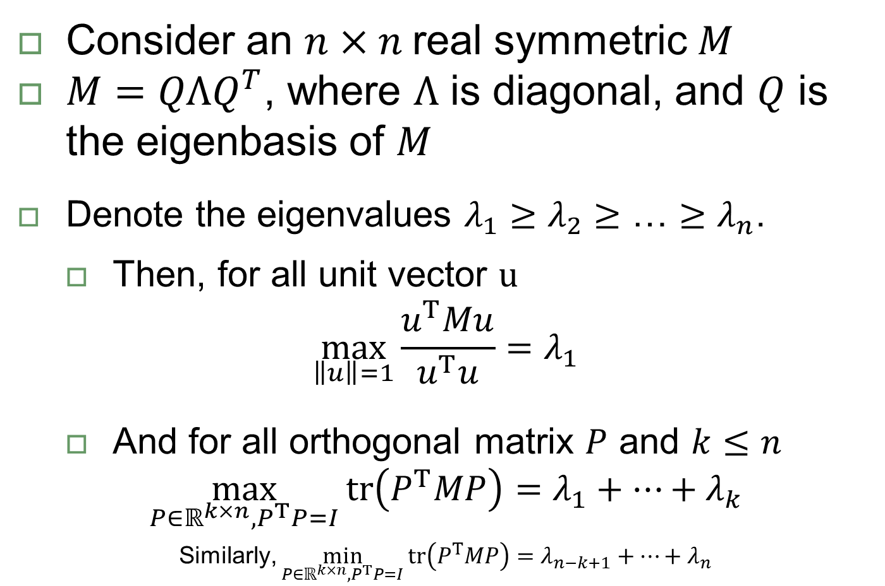
Rayleigh Quotient
Consider an $n×n$ real symmetric $M$
$M=QΛQ^{Τ}$, where $Λ$ is diagonal, and $Q$ is the eigenbasis of $M$
Denote the eigenvalues ${λ_{1}≥λ_{2}≥\text{…}≥λ}_{n}$.
Then, for all unit vector $u$
$$\max_{\left\|u\right\|=1}{\frac{u^{Τ}Mu}{u^{Τ}u}}=λ_{1}$$
And for all orthogonal matrix $P$ and $k≤n$
$$\max_{P∈ℝ^{k×n}, P^{Τ}P=I}{\text{tr}\left(P^{Τ}MP\right)}=λ_{1}+…+λ_{k}$$
Similarly, $\min_{P∈ℝ^{k×n}, P^{Τ}P=I}{\text{tr}\left(P^{Τ}MP\right)}=λ_{n−k+1}+…+λ_{n}$
Min-max Theorem
Similarly, $λ_{n}$ is the minimum of the Rayleigh Quotient
Minimax
Principle

Slide 7
Eigendecomposition applications
Matrix inverse
Matrix approximation
Matrix factorization
Multidimensional Scaling
Minimization or maximization through the Rayleigh Quotient
PCA
Max of covariance matrix
Spectral clustering
Min of graph Laplacian

Slide 8
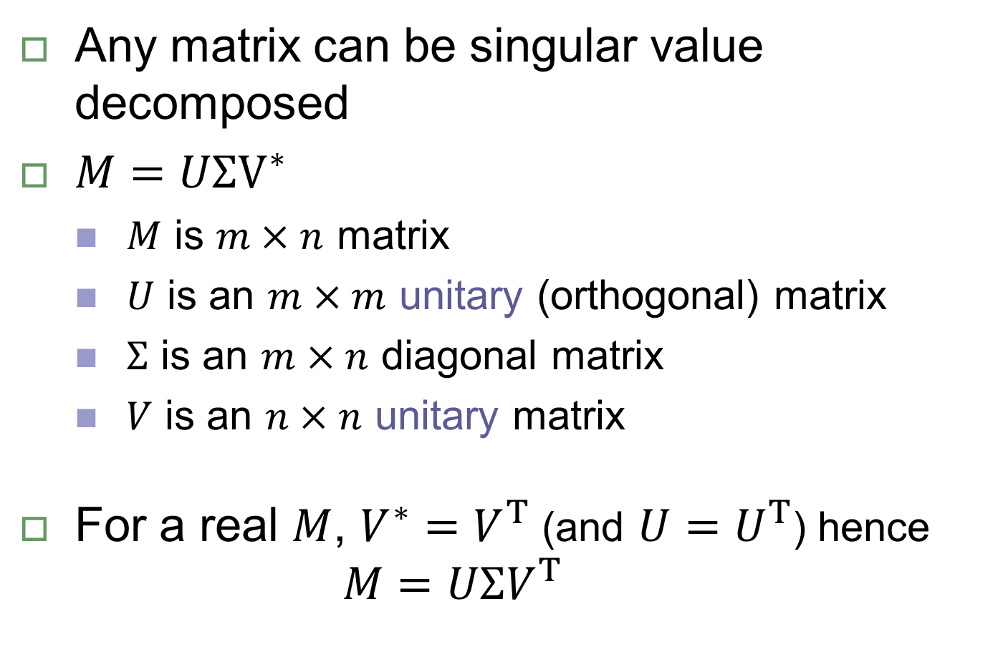
Singular Value Decomposition
Any matrix can be singular value decomposed
$M=UΣV^{∗}$
$M$ is $m×n$ matrix
$U$ is an $m×m$ unitary (orthogonal) matrix
$Σ$ is an $m×n$ diagonal matrix
$V$ is an $n×n$ unitary matrix
For a real $M$, $V^{∗}=V^{Τ}$ (and $U=U^{Τ}$) hence
$$M=UΣV^{Τ}$$

Slide 9
SVD applications
Solving linear equations
Linear regression
Pseudoinverse
Kabsch algorithm
Matrix approximation
As a eigendecomposition (see next slide)

Slide 10
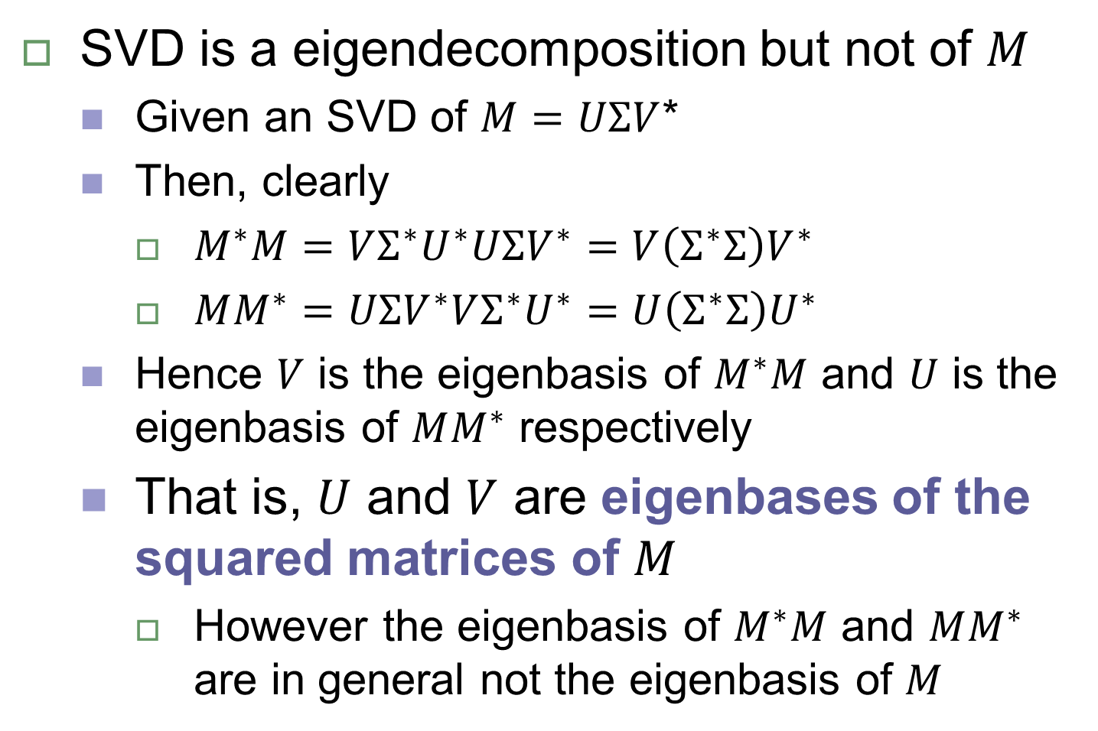
SVD and eigendecomposition
SVD is a eigendecomposition but not of $M$
Given an SVD of $M=UΣV$*
Then, clearly
$M^{∗}M=VΣ^{∗}U^{∗}UΣV^{∗}=V{\left(Σ^{∗}Σ\right)V}^{∗}$
$MM^{∗}=UΣV^{∗}VΣ^{∗}U^{∗}=U{\left(Σ^{∗}Σ\right)U}^{∗}$
Hence $V$ is the eigenbasis of $M^{∗}M$ and $U$ is the eigenbasis of $MM^{∗}$ respectively
That is, $U$ and $V$ are eigenbases of the squared matrices of $M$
However the eigenbasis of $M^{∗}M$ and $MM^{∗}$ are in general not the eigenbasis of $M$

Slide 11
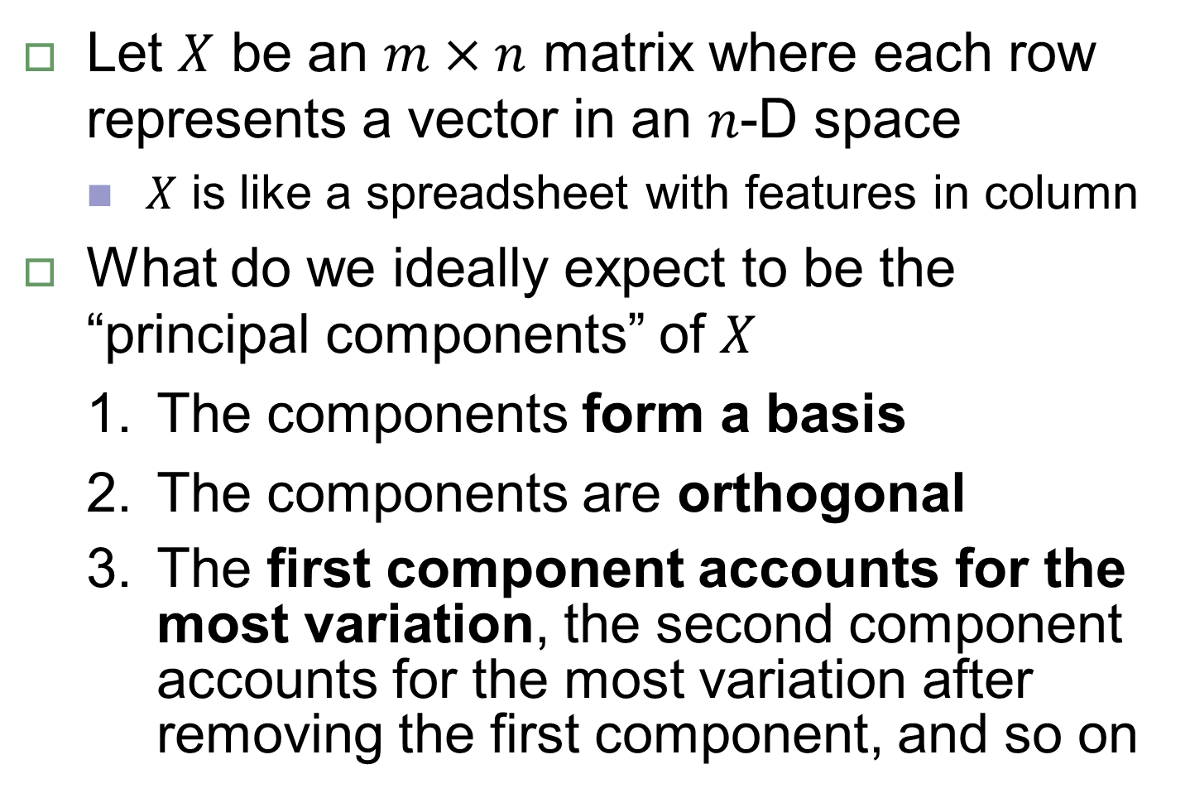
Principal Component Analysis
Let $X$ be an $m×n$ matrix where each row represents a vector in an $n$-D space
$X$ is like a spreadsheet with features in column
What do we ideally expect to be the “principal components” of $X$
The components form a basis
The components are orthogonal
The first component accounts for the most variation, the second component accounts for the most variation after removing the first component, and so on

Slide 12
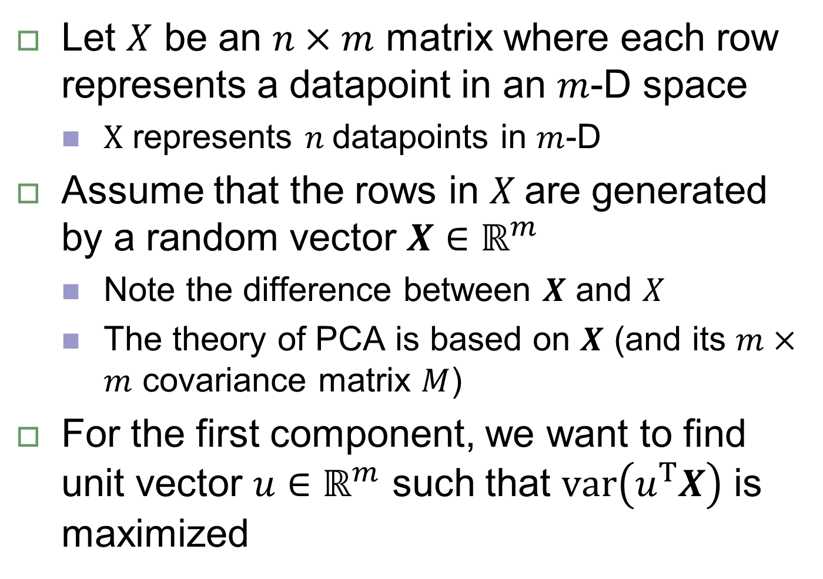
Principal Component Analysis
Let $X$ be an $n×m$ matrix where each row represents a datapoint in an $m$-D space
$X$ represents $n$datapoints in $m$-D
Assume that the rows in $X$are generated by a random vector $X∈ℝ^{m}$
Note the difference between $X$ and $X$
The theory of PCA is based on $X$ (and its $m×m$ covariance matrix $M$)
For the first component, we want to find unit vector $u∈ℝ^{m}$ such that $var\left(u^{Τ}X\right)$ is maximized

Slide 13
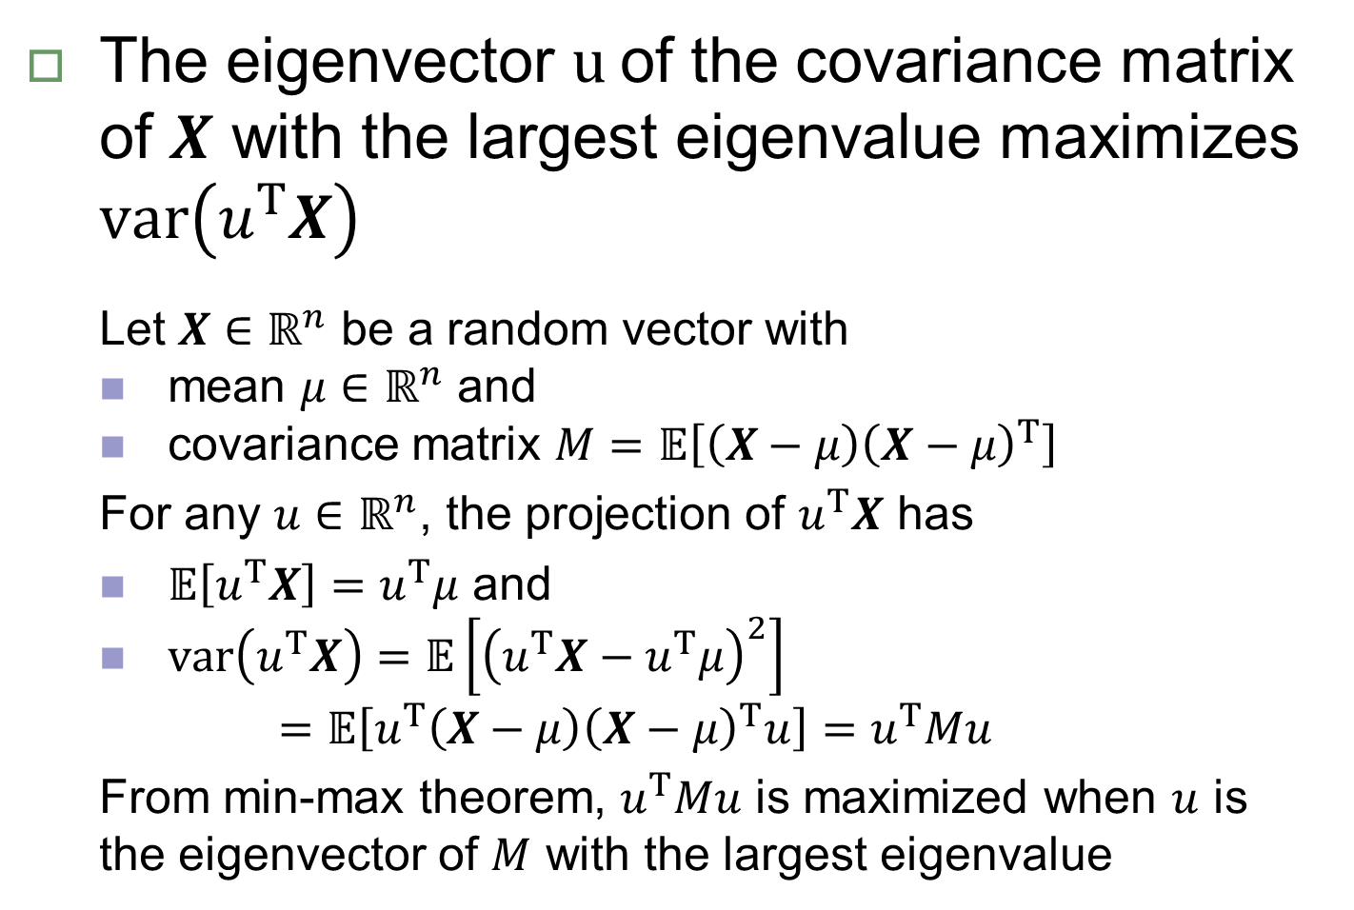
Principal Component Analysis
The eigenvector $u$of the covariance matrix of $X$ with the largest eigenvalue maximizes $var\left(u^{Τ}X\right)$
Let $X∈ℝ^{n}$ be a random vector with
mean $μ∈ℝ^{n}$ and
covariance matrix $M=𝔼\left[\left(X−μ\right){\left(X−μ\right)}^{Τ}\right]$
For any $u∈ℝ^{n}$, the projection of $u^{Τ}X$ has
$𝔼\left[u^{Τ}X\right]=u^{Τ}μ$ and
$var\left(u^{Τ}X\right)=𝔼\left[{\left(u^{Τ}X−u^{Τ}μ\right)}^{2}\right]$
$$=𝔼\left[u^{Τ}\left(X−μ\right){\left(X−μ\right)}^{Τ}u\right]=u^{Τ}Mu$$
From min-max theorem, $u^{Τ}Mu$ is maximized when $u$ is the eigenvector of $M$ with the largest eigenvalue

Slide 14
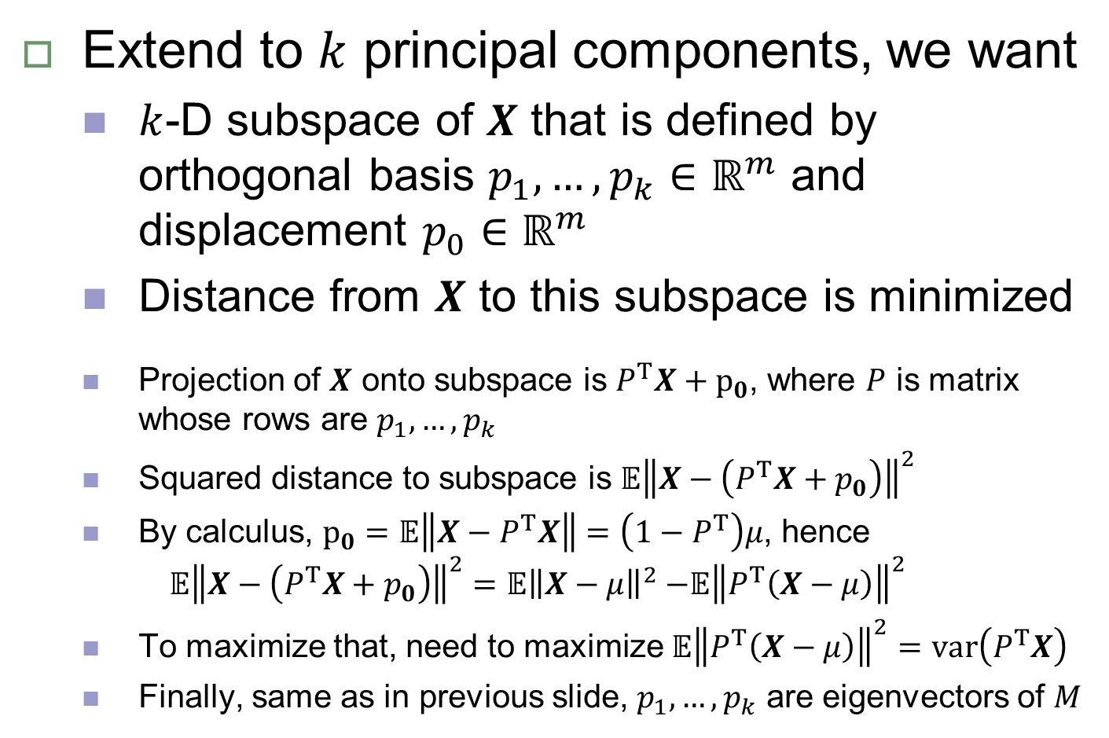
Principal Component Analysis
Extend to $k$ principal components, we want
$k$-D subspace of $X$ that is defined by orthogonal basis $p_{1},…,p_{k}∈ℝ^{m}$ and displacement $p_{0}∈ℝ^{m}$
Distance from $X$ to this subspace is minimized
Projection of $X$ onto subspace is $P^{Τ}X+p_{0}$, where $P$ is matrix whose rows are $p_{1},…,p_{k}$
Squared distance to subspace is $𝔼{\left\|X−\left(P^{Τ}X+p_{0}\right)\right\|}^{2}$
By calculus, $p_{0}=𝔼\left\|X−P^{Τ}X\right\|=\left(1−P^{Τ}\right)μ$, hence
$$𝔼{\left\|X−\left(P^{Τ}X+p_{0}\right)\right\|}^{2}=𝔼{\left\|X−μ\right\|}^{2}{−𝔼\left\|P^{Τ}\left(X−μ\right)\right\|}^{2}$$
To maximize that, need to maximize ${𝔼\left\|P^{Τ}\left(X−μ\right)\right\|}^{2}=var\left(P^{Τ}X\right)$
Finally, same as in previous slide, $p_{1},…,p_{k}$ are eigenvectors of $M$

Slide 15
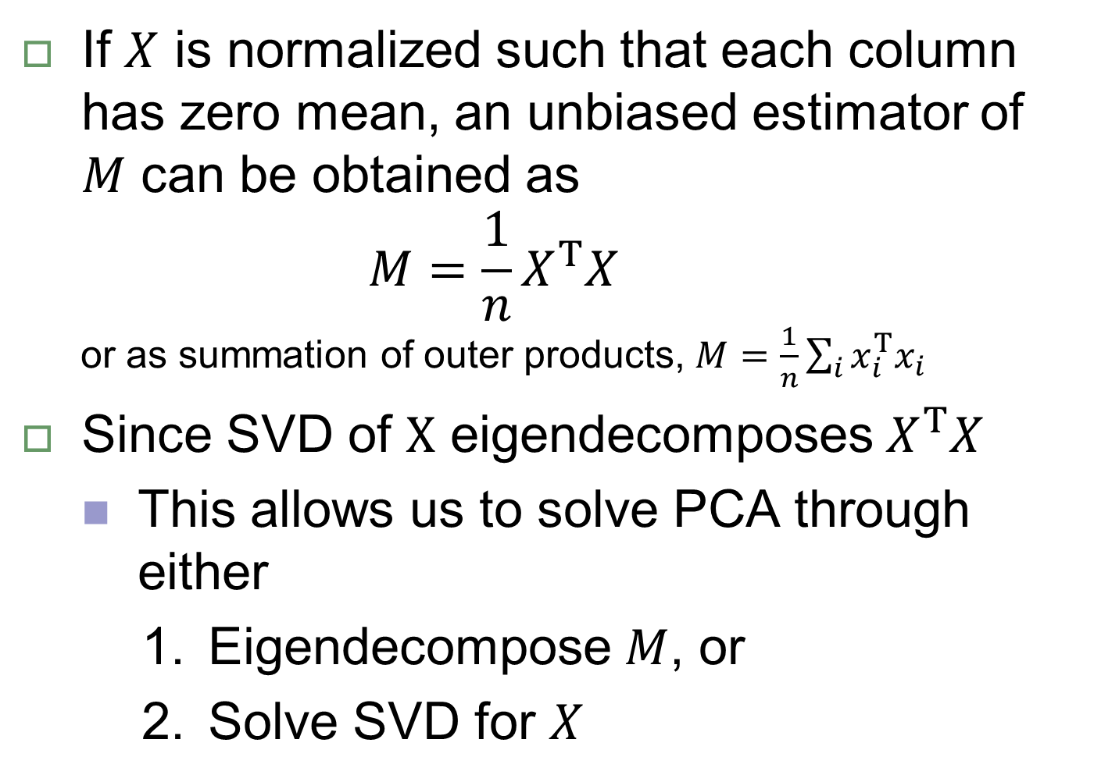
Principal Component Analysis
If $X$ is normalized such that each column has zero mean, an unbiased estimator of $M$ can be obtained as
$$M=\frac{1}{n}X^{Τ}X$$
or as summation of outer products, $M=\frac{1}{n}\sum_{i}{x_{i}^{T}x_{i}}$
Since SVD of $X$ eigendecomposes $X^{Τ}X$
This allows us to solve PCA through either
Eigendecompose $M$, or
Solve SVD for $X$

Slide 16
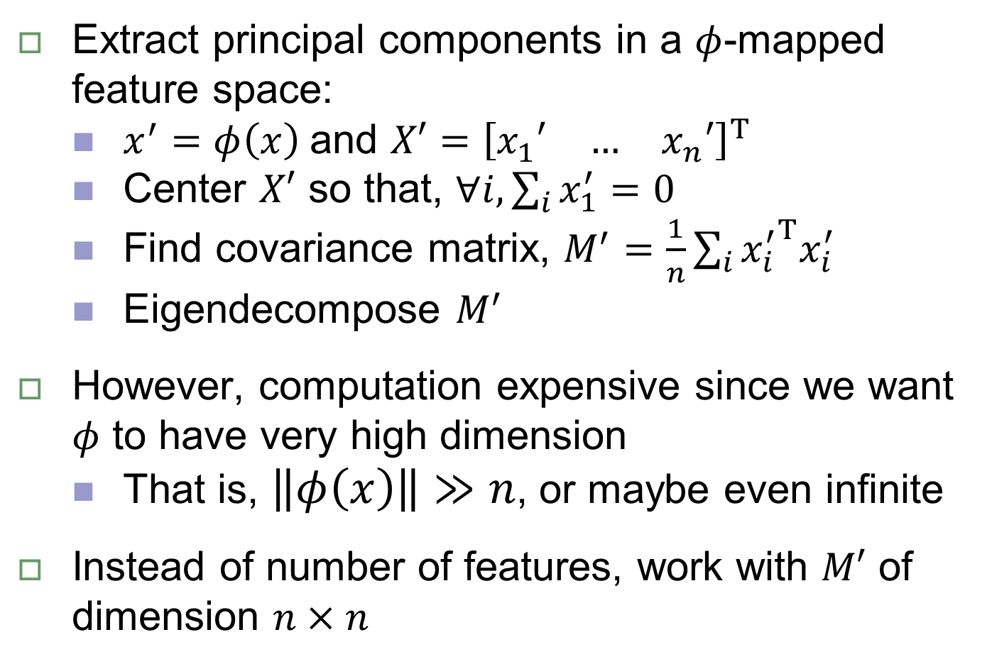
Kernel PCA (kPCA)
Extract principal components in a $φ$-mapped feature space:
$x^{′}=φ\left(x\right)$ and ${X′=\left[\begin{matrix}x_{1}′ & … & x_{n}′\end{matrix}\right]}^{T}$
Center $X′$ so that, $∀i,\sum_{i}{x_{1}^{′}=0}$
Find covariance matrix, $M^{′}=\frac{1}{n}\sum_{i}{{x_{i}^{′}}^{T}x_{i}^{′}}$
Eigendecompose $M^{′}$
However, computation expensive since we want $φ$ to have very high dimension
That is, $\left\|φ\left(x\right)\right\|≫n$, or maybe even infinite
Instead of number of features, work with $M′$ of dimension $n×n$

Slide 17
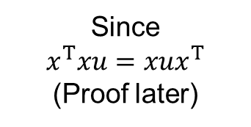
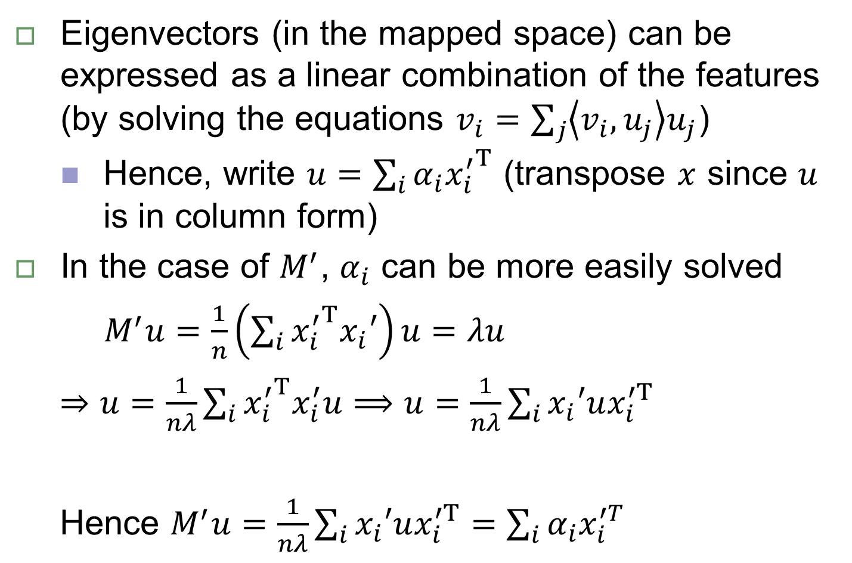
Deriving kPCA
Eigenvectors (in the mapped space) can be expressed as a linear combination of the features (by solving the equations $v_{i}=\sum_{j}{\left\langle v_{i},u_{j}\right\rangle u_{j}}$)
Hence, write $u={\sum_{i}{α_{i}x_{i}^{′}}}^{T}$ (transpose $x$ since $u$ is in column form)
In the case of $M^{′}$, $α_{i}$ can be more easily solved
$M^{′}u=\frac{1}{n}\left(\sum_{i}{{x_{i}^{′}}^{T}x_{i}′}\right)u=λu$
$⇒u=\frac{1}{nλ}\sum_{i}{{x_{i}^{′}}^{T}x_{i}^{′}u}⟹u=\frac{1}{nλ}\sum_{i}{x_{i}′ux_{i}^{′T}}$
Hence $M^{′}u=\frac{1}{nλ}\sum_{i}{x_{i}′ux_{i}^{′T}}=\sum_{i}{α_{i}x_{i}^{′T}}$
Since
$$x^{T}xu=xux^{T}$$
(Proof later)
scalar

Slide 18
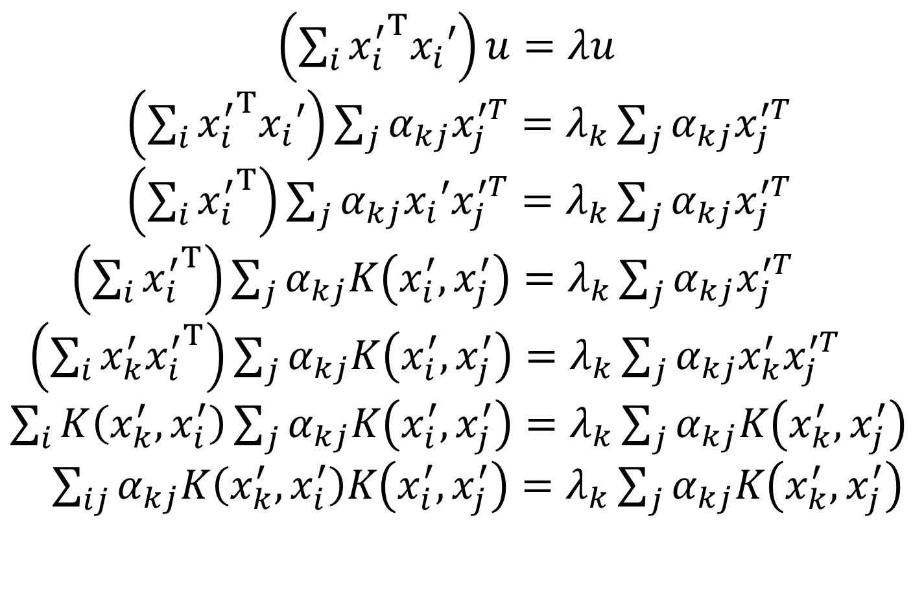
Deriving kPCA
$\left(\sum_{i}{{x_{i}^{′}}^{T}x_{i}′}\right)u=λu$
$\left(\sum_{i}{{x_{i}^{′}}^{T}x_{i}′}\right)\sum_{j}{α_{kj}x_{j}^{′T}}=λ_{k}\sum_{j}{α_{kj}x_{j}^{′T}}$
$\left(\sum_{i}{{x_{i}^{′}}^{T}}\right)\sum_{j}{α_{kj}x_{i}′x_{j}^{′T}}=λ_{k}\sum_{j}{α_{kj}x_{j}^{′T}}$
$\left(\sum_{i}{{x_{i}^{′}}^{T}}\right)\sum_{j}{α_{kj}K\left(x_{i}^{′}, x_{j}^{′}\right)}=λ_{k}\sum_{j}{α_{kj}x_{j}^{′T}}$
$\left(\sum_{i}{x_{k}^{′}{x_{i}^{′}}^{T}}\right)\sum_{j}{α_{kj}K\left(x_{i}^{′}, x_{j}^{′}\right)}=λ_{k}\sum_{j}{α_{kj}x_{k}^{′}x_{j}^{′T}}$
$\sum_{i}{K\left(x_{k}^{′}, x_{i}^{′}\right)}\sum_{j}{α_{kj}K\left(x_{i}^{′}, x_{j}^{′}\right)}=λ_{k}\sum_{j}{α_{kj}K\left(x_{k}^{′}, x_{j}^{′}\right)}$
$\sum_{ij}{α_{kj}K\left(x_{k}^{′}, x_{i}^{′}\right)K\left(x_{i}^{′}, x_{j}^{′}\right)}=λ_{k}\sum_{j}{α_{kj}K\left(x_{k}^{′}, x_{j}^{′}\right)}$

Slide 19
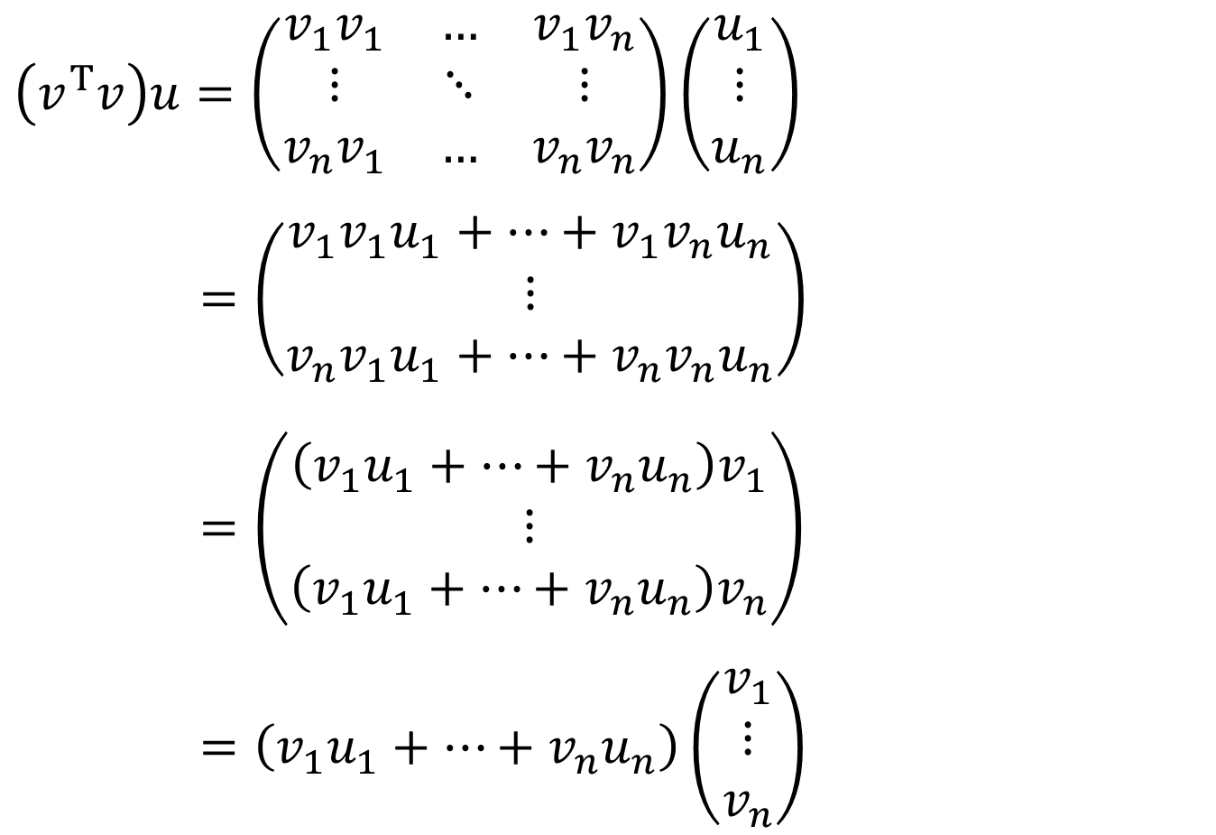

Proof that $x^{T}xu=xux^{T}$
$\left(v^{T}v\right)u=\left(\begin{matrix}v_{1}v_{1} & … & v_{1}v_{n} \\ ⋮ & ⋱ & ⋮ \\ v_{n}v_{1} & … & v_{n}v_{n}\end{matrix}\right)\left(\begin{matrix}u_{1} \\ ⋮ \\ u_{n}\end{matrix}\right)$
$=\left(\begin{matrix}v_{1}v_{1}u_{1}+…+v_{1}v_{n}u_{n} \\ ⋮ \\ v_{n}v_{1}u_{1}+…+v_{n}v_{n}u_{n}\end{matrix}\right)$
$=\left(\begin{matrix}\left(v_{1}u_{1}+…+v_{n}u_{n}\right)v_{1} \\ ⋮ \\ \left(v_{1}u_{1}+…+v_{n}u_{n}\right)v_{n}\end{matrix}\right)$
$=\left(v_{1}u_{1}+…+v_{n}u_{n}\right)\left(\begin{matrix}v_{1} \\ ⋮ \\ v_{n}\end{matrix}\right)$

